Slide 1
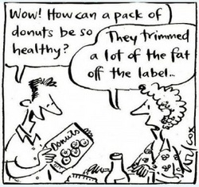
Food Labels
Fact, Not Fiction

Slide 2
Purpose
Our goal was to find out exactly how food labels were misleading. We wanted to know how the food label lexicon manipulates consumers into buying this product over that. Through our research we wanted to figure out HOW we can expose food labels. If we know WHY we can’t trust food labels, then we will know WHY it’s important to make conscious decisions about what we eat.

Slide 3
We’re interested in food labels because…
With the growing obesity epidemic, more and more people are trying to eat healthier.
Consumers are turning to food labels to help choose which products to buy, when most aren’t even FDA backed or regulated.
We want to know what makes food labels so confusing and how companies mislead people into thinking what they’re eating is healthy, when it isn’t necessarily.

Slide 4
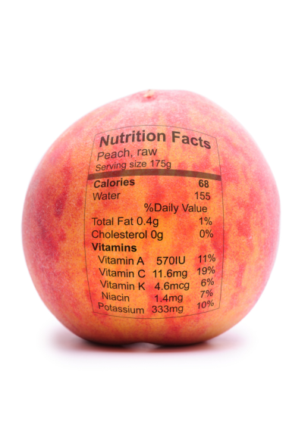
QUICK TIP: Ingredient lists begin with the ingredient that’s used most in the product. So whatever’s labeled first is the main ingredient.

Slide 5
Popular Terms
“Zero grams trans fat”
“All-Natural”
“Heart Healthy”
“Low Car”
“Fresh”
“Made from Real Source of…”
“Organic”

Slide 6
Truth Behind the Terms
“Zero grams trans fat” : If the serving size is less than 0.5g, it can be labeled as trans fat free.
“All-Natural” : Products labeled all natural must be free of artificial colors and ingredients and must be minimally processed. But since there are no standards to define “minimally processed”. There is NO legal term.
“Low Carb” : Even if the amount of carbohydrates are low in a product, the front-of-the-package label often doesn't provide information on other less-than-healthy ingredients such as saturated fat and transfatty acids.
“Fresh” : Lead to believe just came fresh from the farm.
“Made from Real Source of…” : Means the food started with this product, but little may remain of them. It also means it can be made with very little of this product. For example, Fruit snacks say made with real fruit, but how much of it is made with sugar?
“Whole Wheat” : Refined flour, is a wheat or grain, but doesn’t give the same benefits as 100% whole wheat. For example, to find out if a “whole wheat” product is really whole wheat, the first ingredient listed must be whole wheat. However, you have to keep reading to make sure there aren’t added sugars.
“Organic” : Strictly how it’s grown. You can have organic potato chips, they’re no different nutritious wise from regular potato chips.

Slide 7
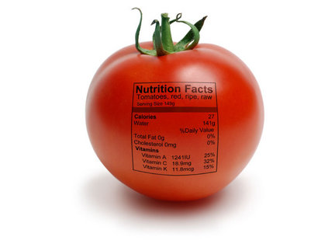
QUICK TIP: If a product claims “Og of trans fat” look on the ingredients list. If it says “hydrogenated”, “shortening”, “partially hydrogenated vegetable oils”. These are all trans fat. (Trans fat raise bad cholesterol, and lower good cholesterol.)

Slide 8
What We Discovered…
…Is food labels are there more to confuse than inform.
We had trouble figuring out what means what & how to calculate the nutritional facts panel.
Even a meatpacker at a local ShopRite didn’t know the terms. We asked him what “all-natural” meant and he responded with, no hormones. Yeah, it said that on the package, but that was the extent of his knowledge about guidelines.
In an interview with Jenn Boucher, who recently lost weight due to her reading food labels, we asked her about what she thought about misleading food labels.
She said, “I do look at ingredients, but a lot of the times I can’t pronounce them so I don’t think that’s a good sign. So I guess try to pick items that are healthy and only have limited ingredients.”
Does anyone know the facts behind nutritional facts?

Slide 9
But How Can lil ole Us Combat Major Corporations?
Educate yourself, and others.
Know what you’re eating.
Take the time to learn how to interpret food labels. Learn what it means to really be nutritious & healthy.
FDA.gov is a great place to start.
Be an example, “Eat your vegetables, because your children are watching.”

Slide 10
Tips to Eating Healthier
Learn how to understand and use the Nutritional Facts Panel
Everything in moderation, look at the bigger picture.
First look at the serving size. If the serving size is off, all your numbers will be, too.
Start a food log so you know how much of each Daily Percent Value you’re meeting.
Daily Percent Value is based on 2,000-2,5000 calorie diet. Everything 5% or less is low, and everything 20% or more is high.
“You shop the perimeter of the store. You grab your perishables- your fruits and vegetables, you're whole grains, your lean meat, your low fat dairy, your seafood, and you go into the grocery aisle as you need to so you can cut down on the amount of processed and prepared foods that are in your diet.”
–Registered Dietician Meghan Locantora

Slide 11
Diseases Associated with Obesity…(there are more than these listed)
Diabetes
Types of Cancer:
Congestive Heart Failure
Heart Enlargemen
Stroke
Polycystic Ovarian Syndrome
Pulmonary Embolism
Gastro-esophageal Reflux or Heartburn
Osteoarthritis
Fatty Liver Disease
Erectile Dysfunction
Chronic Renal Failure
Lymph Edema
Urinary Incontinence
Depression
Cellulitis
Gallbladder Disease
Gout
Pickwickian Syndrome
Hernia

Slide 12
Why You? Glad you Asked!
College students may think understanding and using the food label is trivial. Or maybe because of hegemony (force + consent), people don’t even think twice about what they’re eating. Or maybe still they’re only concerned with losing weight and not quite being healthy.
Now is the perfect time for college students to break free from their eating habits. You’re young, beginning to live on your own, and are making other important life decisions.
What you’re eating should be important to you. Nobody will take care of your body, except for you. This also means don’t forget to exercise. Health & exercise go hand in hand.
Make the right lifestyle choices.

Slide 13
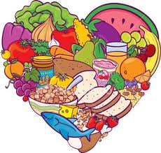
By: Ashley Approvato, Brittany Barger, Kim Ostrander

